Slide 1



proyecto de cero a analista de datos power bi Rdouglas
View in Power BI
Last data refresh:
02/01/2022 2:56:07 UTC
Downloaded at:
02/01/2022 2:58:53 UTC

Slide 2
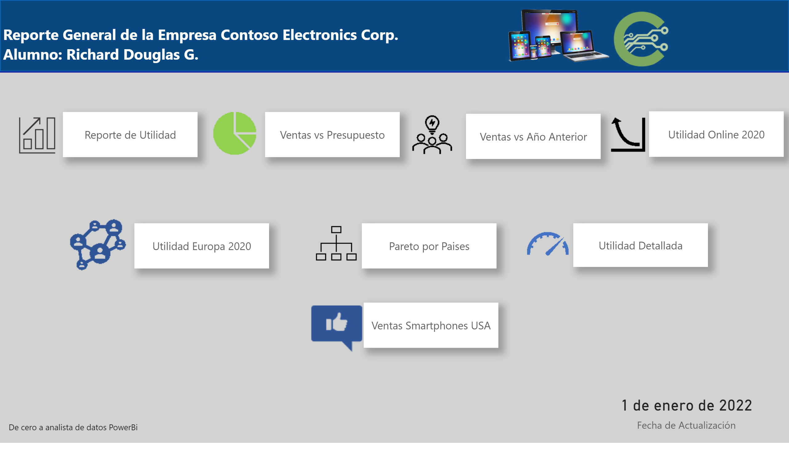
Menu
Notes:
actionButton
No alt text provided
actionButton
No alt text provided
actionButton
No alt text provided
actionButton
No alt text provided
actionButton
No alt text provided
textbox
No alt text provided
shape
No alt text provided
actionButton
No alt text provided
shape
No alt text provided
image
No alt text provided
image
No alt text provided
image
No alt text provided
image
No alt text provided
image
No alt text provided
image
No alt text provided
actionButton
No alt text provided
image
No alt text provided
card
No alt text provided
image
No alt text provided
image
No alt text provided
actionButton
No alt text provided
image
No alt text provided
textbox
No alt text provided

Slide 3
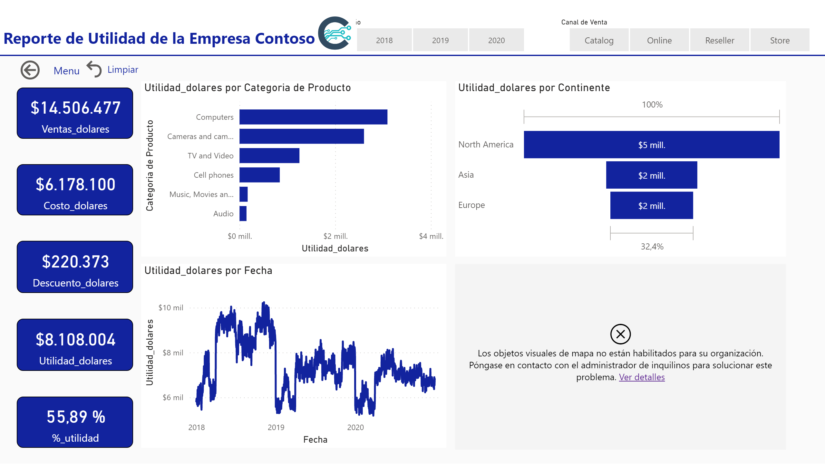
Reporte Utilidad
Notes:
card
No alt text provided
card
No alt text provided
card
No alt text provided
card
No alt text provided
card
No alt text provided
clusteredBarChart
No alt text provided
lineChart
No alt text provided
funnel
No alt text provided
map
No alt text provided
slicer
No alt text provided
slicer
No alt text provided
textbox
No alt text provided
shape
No alt text provided
shape
No alt text provided
actionButton
No alt text provided
actionButton
No alt text provided
image
No alt text provided

Slide 4
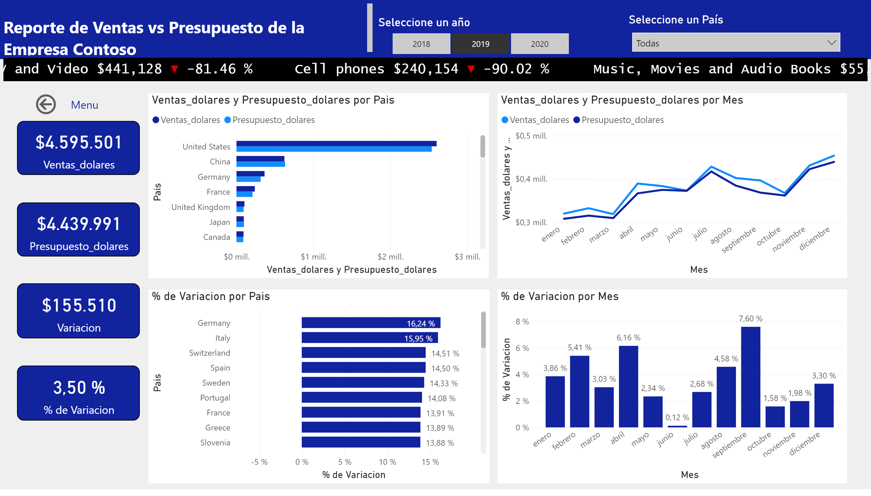
Reporte Ventas vs Presupuesto
Notes:
card
No alt text provided
card
No alt text provided
card
No alt text provided
card
No alt text provided
clusteredBarChart
No alt text provided
lineChart
No alt text provided
clusteredColumnChart
No alt text provided
Seleccione un año
No alt text provided
textbox
No alt text provided
shape
No alt text provided
shape
No alt text provided
clusteredBarChart
No alt text provided
Seleccione un País
No alt text provided
actionButton
No alt text provided
ScrollingTextVisual1448795304508
No alt text provided

Slide 5
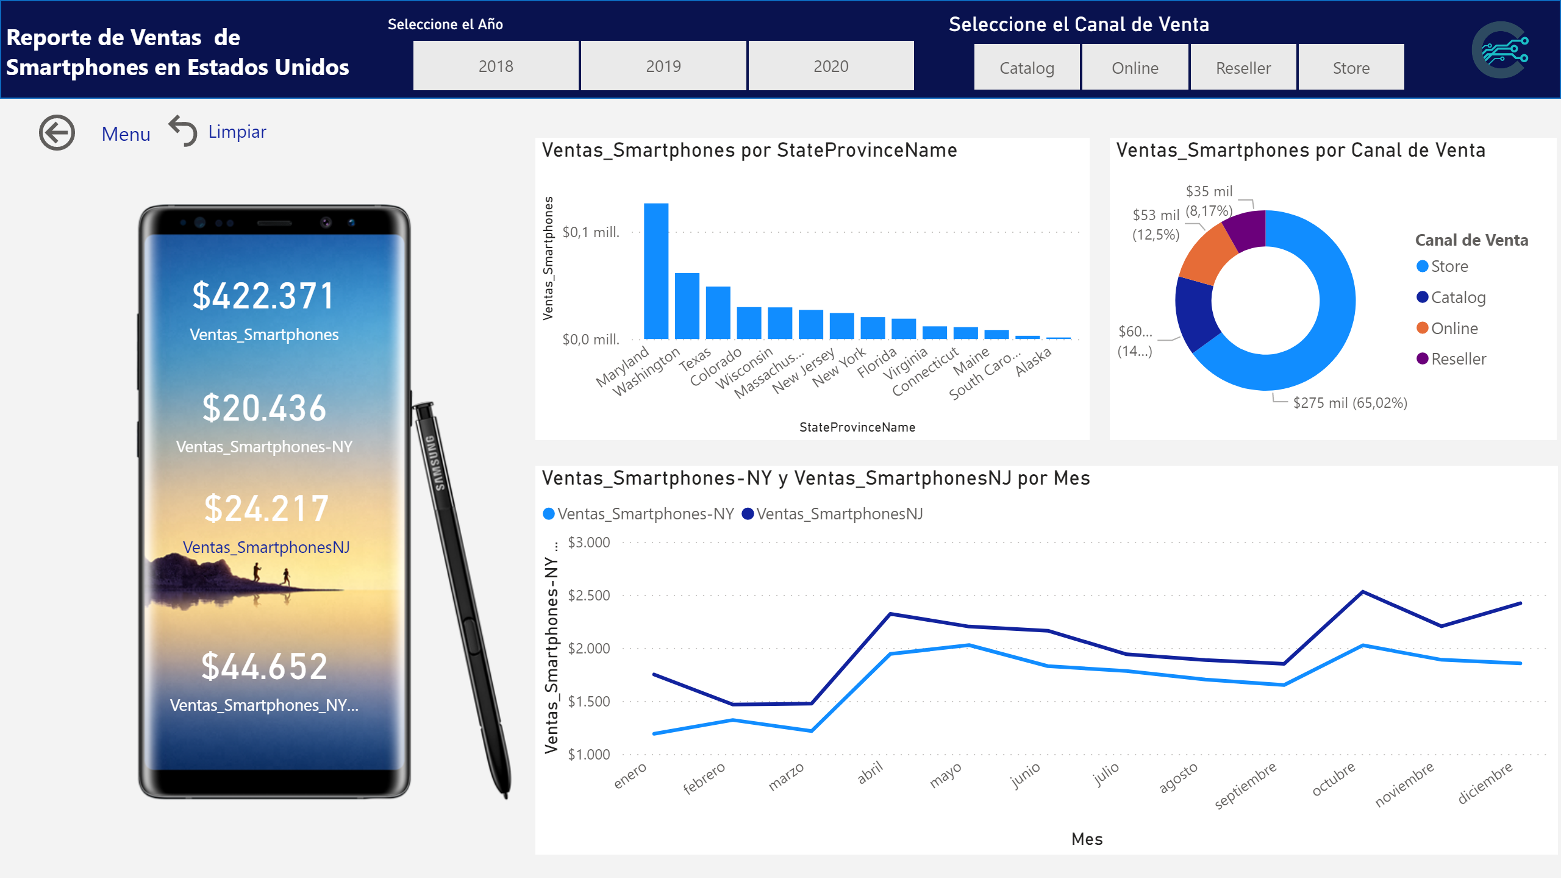
reporte calculate
Notes:
card
No alt text provided
card
No alt text provided
card
No alt text provided
card
No alt text provided
clusteredColumnChart
No alt text provided
donutChart
No alt text provided
lineChart
No alt text provided
Seleccione el Año
No alt text provided
Seleccione el Canal de Venta
No alt text provided
image
No alt text provided
textbox
No alt text provided
shape
No alt text provided
image
No alt text provided
actionButton
No alt text provided
actionButton
No alt text provided

Slide 6
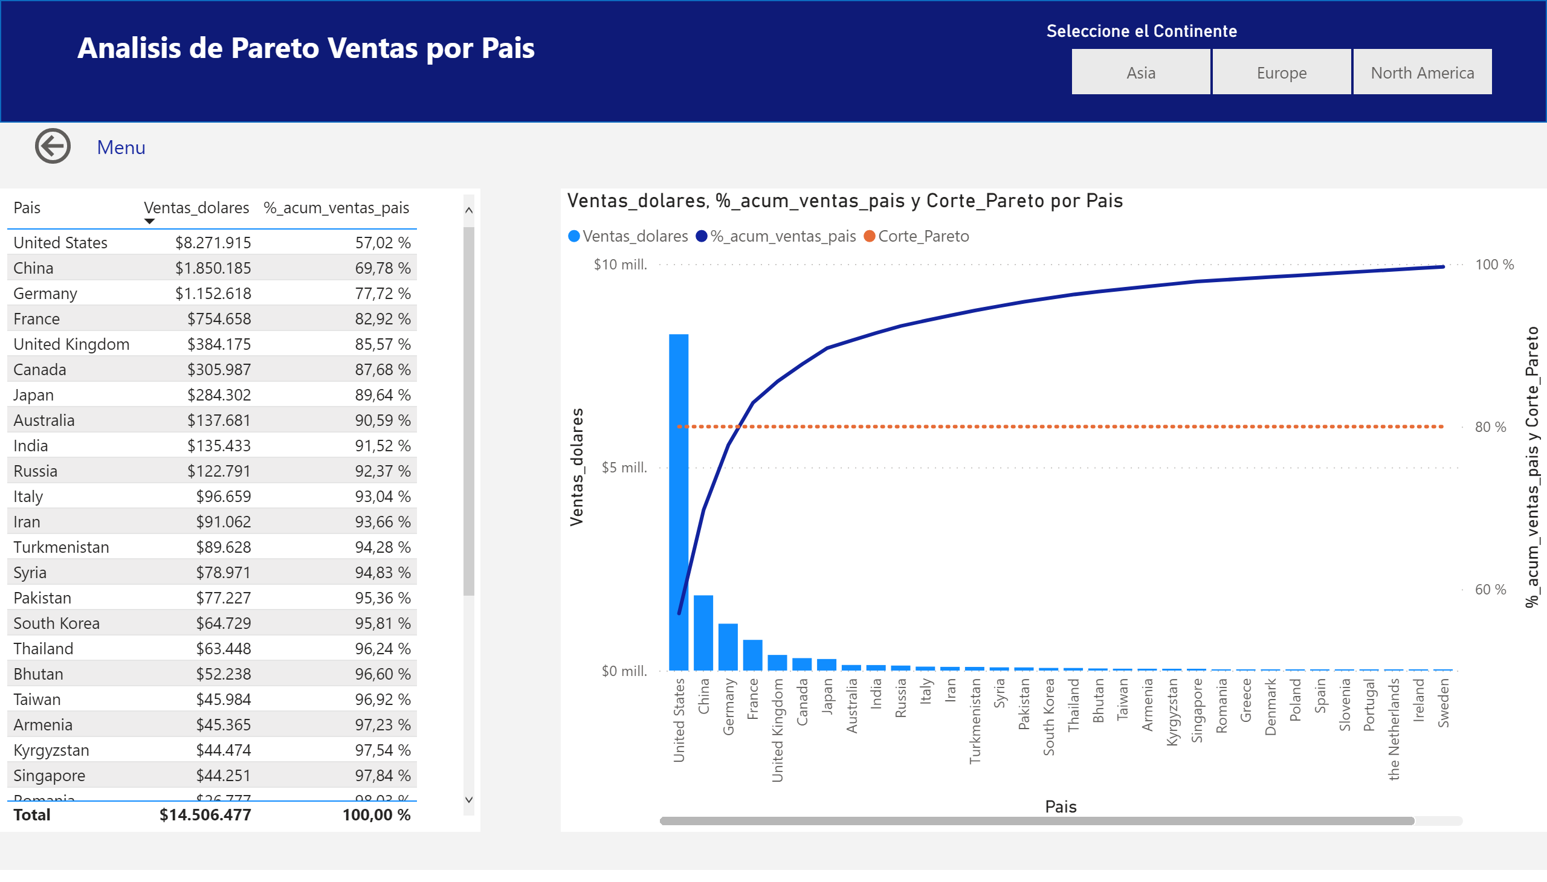
Pareto Paises
Notes:
tableEx
No alt text provided
Seleccione el Continente
No alt text provided
shape
No alt text provided
lineClusteredColumnComboChart
No alt text provided
textbox
No alt text provided
actionButton
No alt text provided

Slide 7
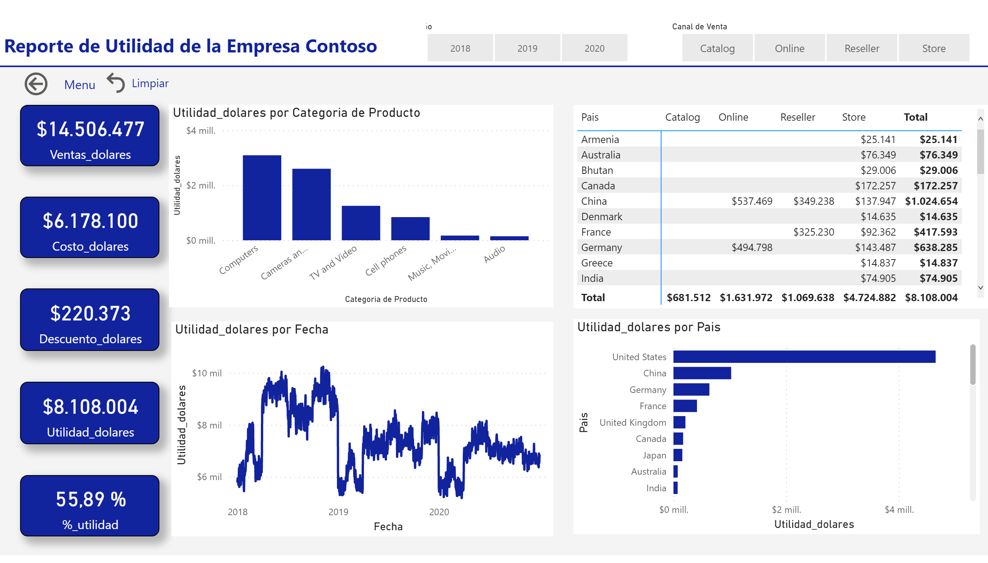
Editar Interacciones
Notes:
card
No alt text provided
card
No alt text provided
card
No alt text provided
card
No alt text provided
card
No alt text provided
clusteredColumnChart
No alt text provided
lineChart
No alt text provided
slicer
No alt text provided
slicer
No alt text provided
textbox
No alt text provided
shape
No alt text provided
shape
No alt text provided
clusteredBarChart
No alt text provided
pivotTable
No alt text provided
actionButton
No alt text provided
actionButton
No alt text provided

